Slide 1
AC METERS

Slide 2
WHY MEASUREMENTS ARE DONE
For operating with the circuit
Repair of the AC Circuits

Slide 3
AC MEASUREMENTS
Current
Voltages
Resistances
Power
Frequency

Slide 4
AC METERS
Moving Coil Meter Movement—D’Arsonval meter movement.
Moving Coil meters are used to measure DC Currents.
To measure AC current on this meter
----AC Current converted to DC(done by ???)

Slide 5
IRON VANE METER MOVEMENT
Donot require the conversion
VIDEO
Disadvantage:
Require more current for full scale deflection then moving coil meter movement. Therefore, little applications for low power circuits.
It is also inaccurate for frequencies above 100 Hz. Used majorly for 60 Hz applications.
Non-linear scale
Because current flowing is not directly proportional to amount of repulsion.

Slide 6
CLAMP ON METERS
Principle: ELECTROMAGNETIC INDUCTION
AC Current flowing through a conductor causes a magnetic field to expand and collapse.
Used for measuring high values of AC Current.

Slide 7
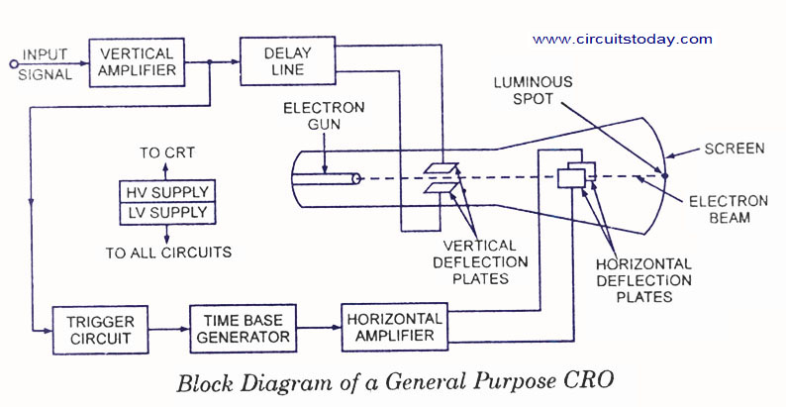
OSCILLOSCOPE

Slide 8
OSCILLOSCOPE POINTS
CRT-Heart of CRO
Horizontal and vertical deflection plates operation
Role of Delay line
Delay time by delay line
Trancing and retracing time
About screen-phosphor screen-KE to light energy
HV and LV supply
Volts/ div and time/div

Slide 9
OSCILLOSCOPE
Intensity (Brightness) switch
Focus and Astigmatism control (for size and shape of the electron beam)
Horizontal and vertical position controls (to position the electron beam )

